Slide 1
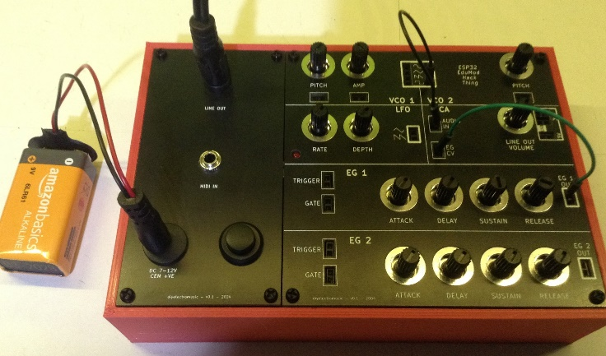
The Educational DIY Synth Thing
Project Selection – v0.1 – June 2025
© diyelectromusic 2025
https://diyelectromusic.com/2024/05/07/educational-diy-synth-thing/

Slide 2
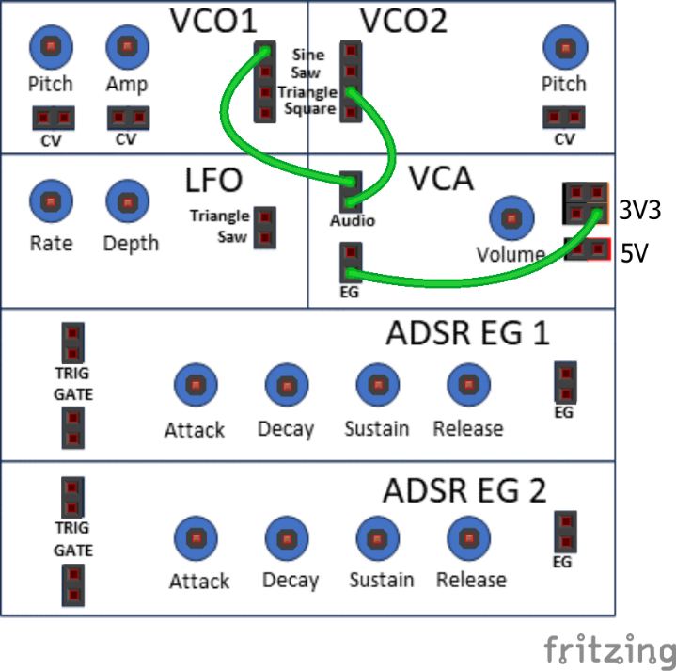
2. Dual Oscillator Output
Change:
VCO1 and VCO2 Pitch.
VCO1 Amp.
VCO1 and VCO2 Waveforms.
Experiments:
Tune to same pitch.
Detune one slightly.
Tune to 1 octave apart.
Tune to 2 octaves.
Find other intervals.

Slide 3
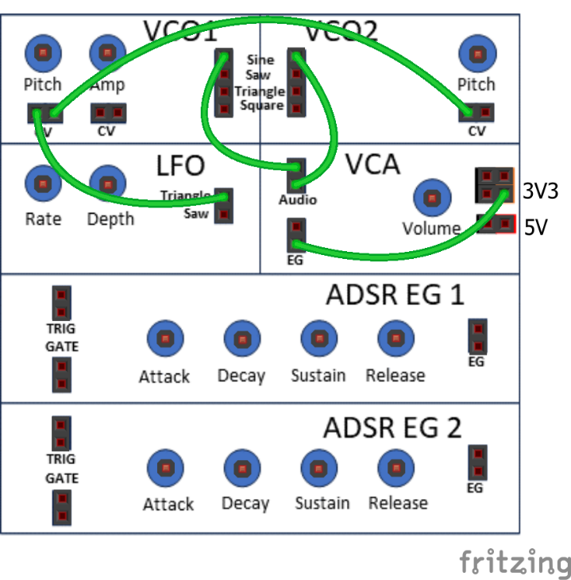
3. Dual VCO+LFO Pitch Modulation
Links VCO1 and VCO2 CVs.
Turn LFO off and tune VCOs to 1 octave.
Try LFO Rate and Depth.
Try LFO waveforms.
Connect one LFO waveform to VCO1 and one to VCO2.

Slide 4
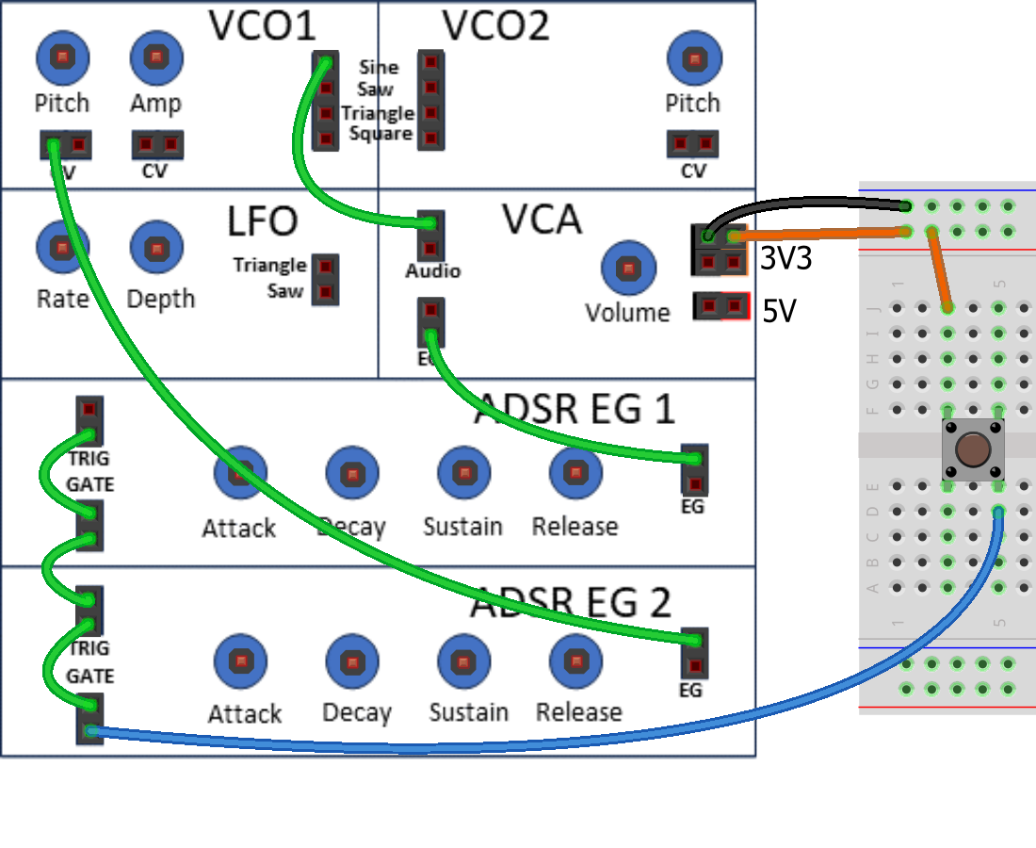
4. ADSR Envelope Generator for Amplitude and Pitch
EG1 back to controlling VCA.
EG2 now controlling VCO Pitch.
Try different A, D, S, R settings for both amplitude and pitch.

Slide 5
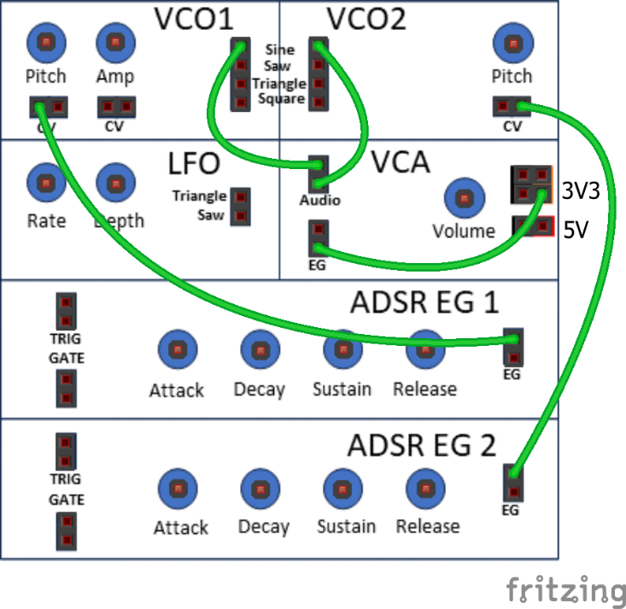
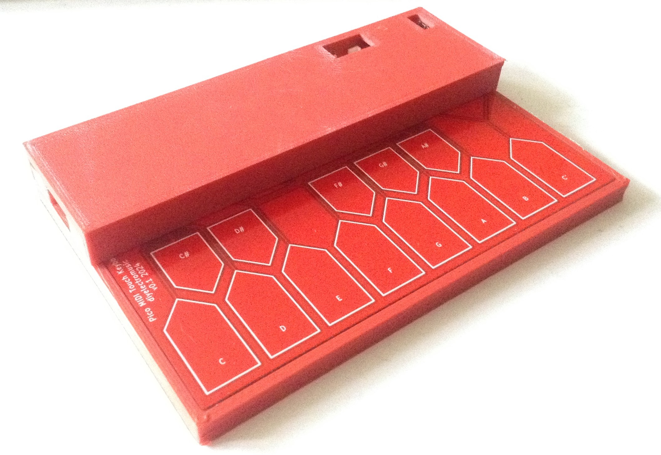
5. ADSR Envelope Generator – Dual Pitch
Start with:
Both Pitch controls turned right down.
Low Sustain (S) level on each EG.
Play some notes.
Experiment with:
Both sets of ADSR Settings.
Detuning VCO2.
Setting VCOs an octave apart.
Different waveforms.

Slide 6
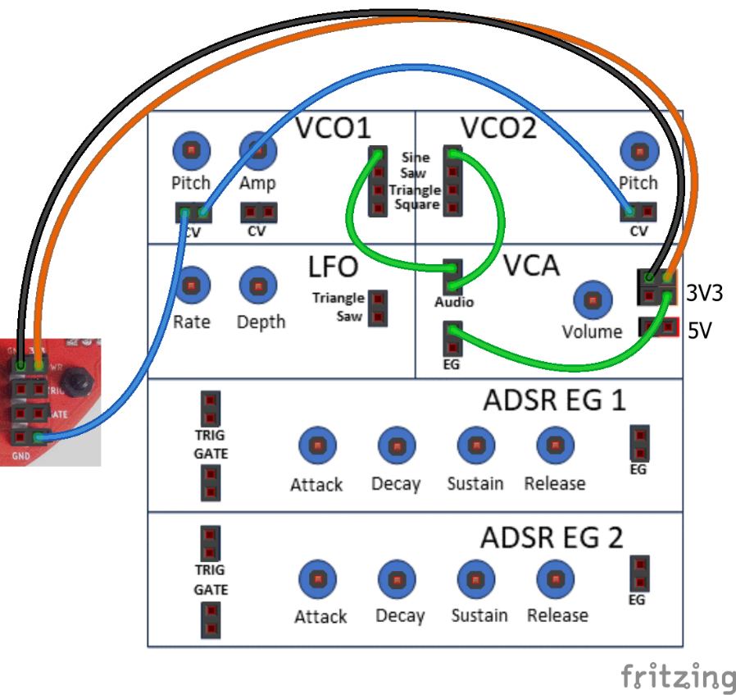
6. Dual Pitch Sequence
Both VCOs connected.
Start with:
VCO Pitch controls turned right down.
VCO1 Amp and VCA Volume right up.
Baby 8 steps fully clockwise (8 steps).
Baby 8 Run/Stop -> Run (to the right).
Experiment with:
Detune VCO2.
Different Waveforms.
Different Pitch controls.
Adjust the sequence.

Slide 7
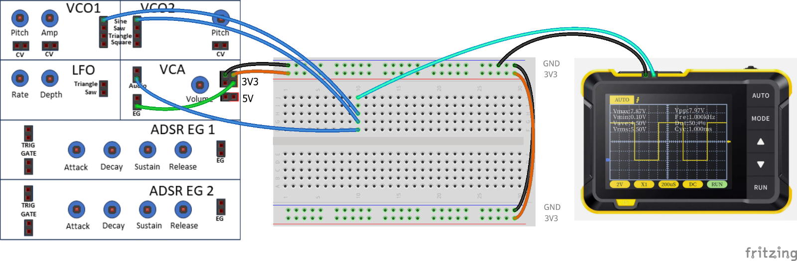
7. Dual Oscillators and Oscilloscope
Setup:
VCA Amp turned fully clockwise.
VCO1 Amp fully anticlockwise (off).
VCO1 and VCO2 Pitch half-way.
Use both Sine outputs.
Experiment:
Slowly increase VCO1 Amp.
Tune both VCOs to same Pitch.
Watch how the waveform slowly changes.

Slide 8
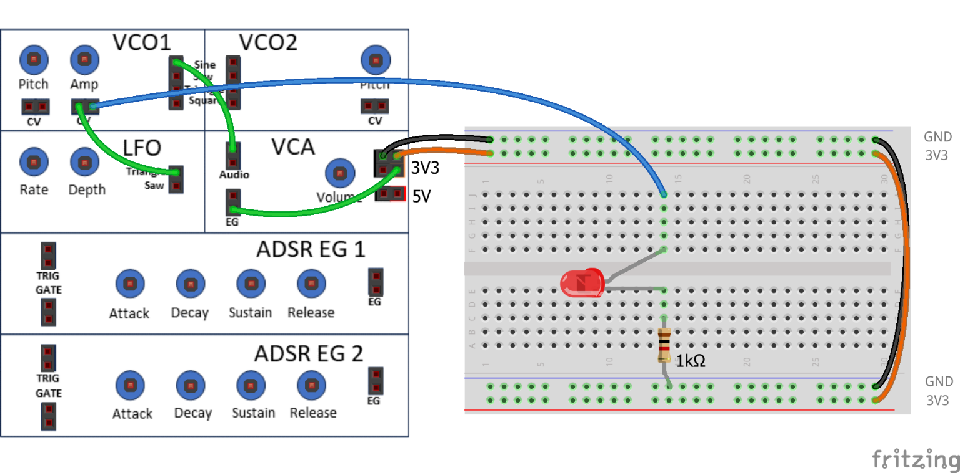
8. LED Indicator
Experiment with:
LFO Rate
LFO Depth
LFO Waveform
Contrast fast rate with very slow rate.
Setup
VCO1 Amp fully anti-clockwise (“off”).
VCO1 Pitch half-way.
LFO Depth half-way.
LFO Rate fully anti-clockwise (“slow”).

Slide 9
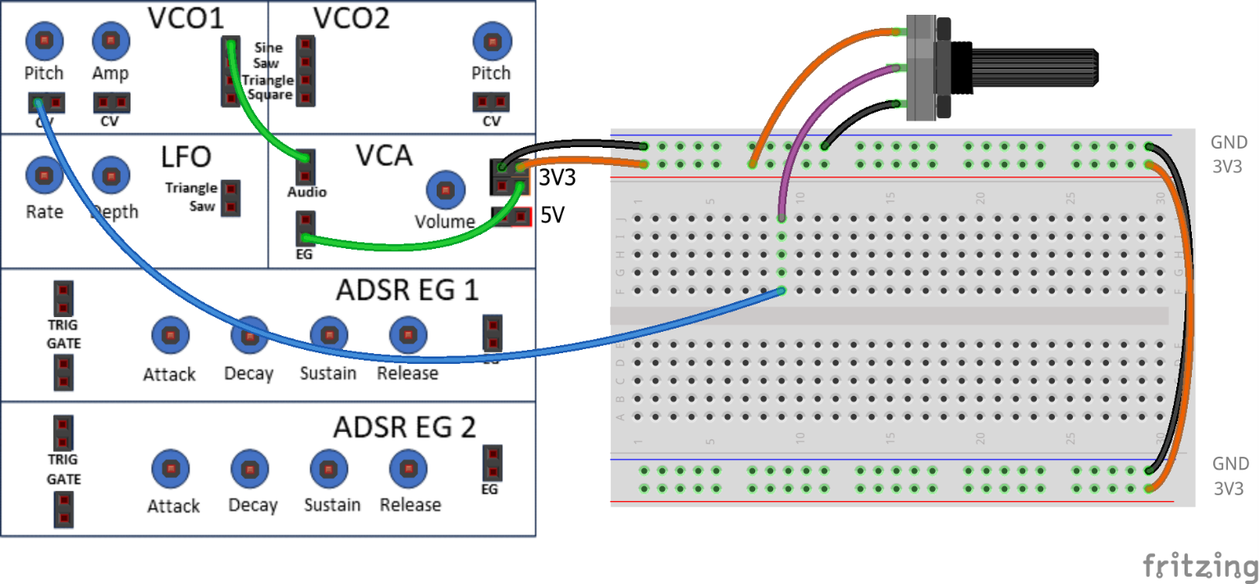
9. Potentiometer Control
Experiment with:
VCO1 Pitch
Pot Control
Notice how the two add to each other…
Setup
Pot between 3V3 and GND.
VCO1 Amp and VCA Vol fully clockwise.

Slide 10
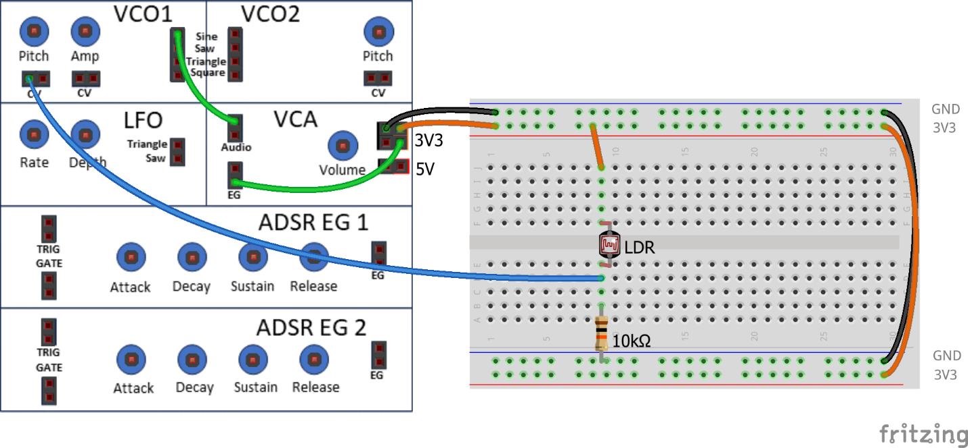
10. Light Dependant Resistor Control
Move hand over the LDR.
Experiment with different positions from fully covered to fully open.
This simulates an instrument called a “Theremin”.
Setup
VCO1 Pitch half-way.
VCO1 Amp and VCA Vol fully clockwise.

Slide 11
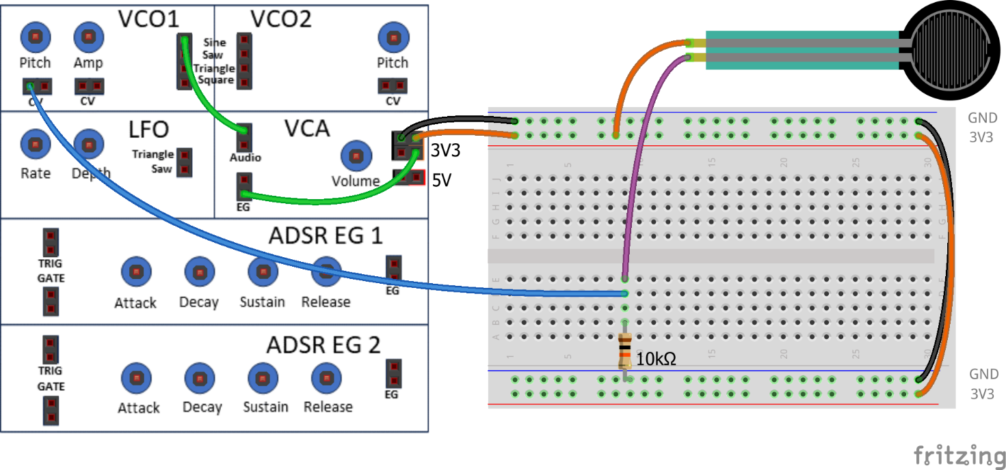
11. Force Sensitive Resistor Control
Apply Pressure to the FSR…
Now acts as a “pitch bend” for the Synth Thing.
Setup
FSR between 3V3 and via 10KΩ resistor to GND.
VCO1 Amp and VCA Vol fully clockwise.
VCO1 Pitch half-way.

Slide 12
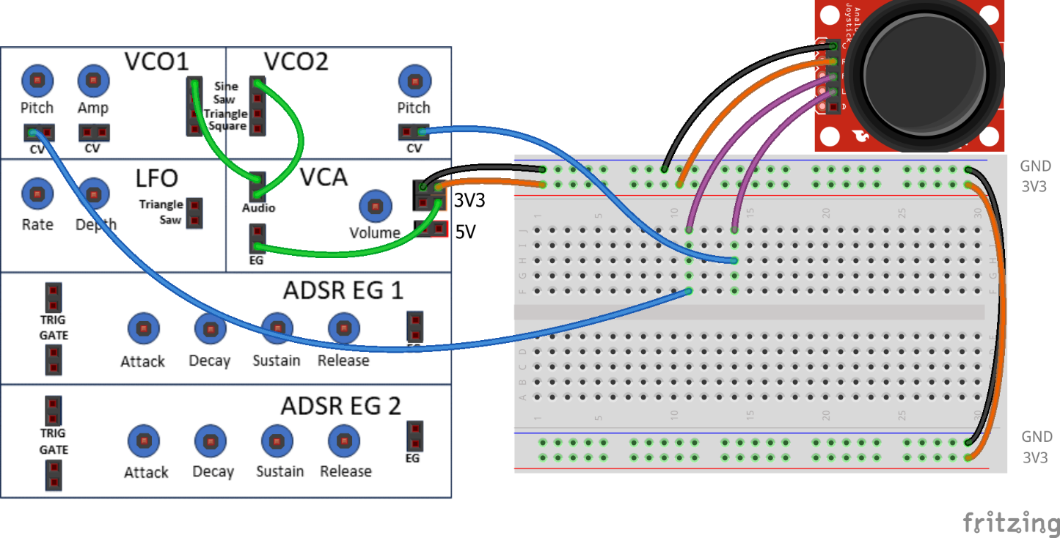
12. “Thumb” Joystick Control
Joystick is two potentiometers.
Experiment with different directions.
This now acts as a simple “dual pitch bend” for the Synth Thing.
Setup
“X” output to VCO1 CV, “Y” output to VCO2 CV.
Double check wiring of the joystick module.
VCO1 Amp and VCA Vol fully clockwise.
VCO1 and VCO2 Pitch half-way.

Slide 13
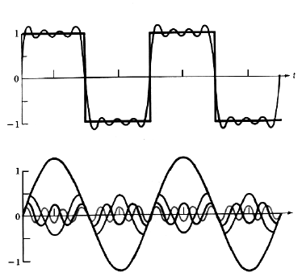
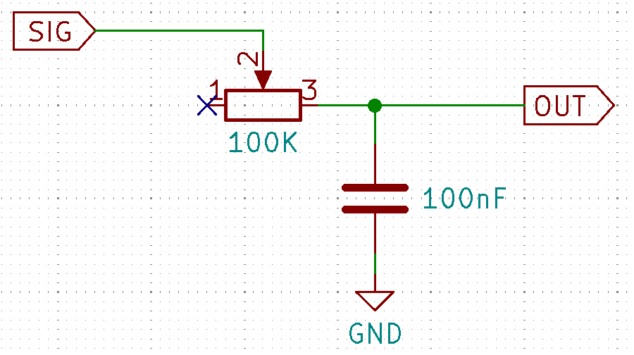
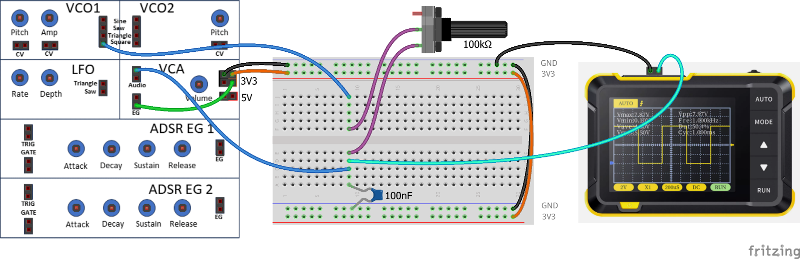
13. Adjustable Low-pass Filter
Setup
VCO1 Amp and VCA Amp fully clockwise.
VCO1 Pitch half-way.
Use the VCO1 square wave output.
Turn the external potentiometer either fully clockwise or fully anti-clockwise until a square wave can be seen on the oscilloscope.
Gradually turn the external potentiometer and note what happens to the resulting waveform – both by listening and by looking at the oscilloscope.
Repeat the experiment with the saw, triangle and sine waves in that order.

